Slide 1
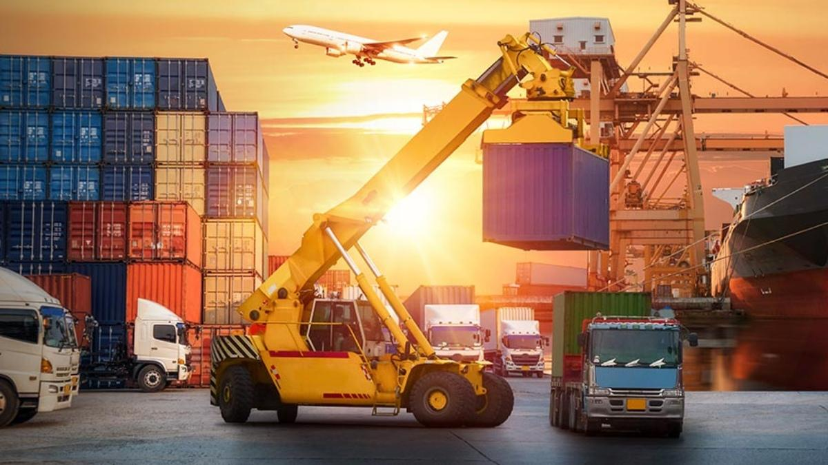
Logistics Policy
Sravan Kumar Mangalagiri @smangala
Yashanjali Chavan @ychavan
Indraneel Somayajula @isomayaj

Slide 2
What is Logistics Policy ?
In Basic terms , logistics policy is a project which aims to promote seamless movement of goods across the country. The process of coordinating and moving resources - people, materials,inventory, and equipment - from one location to storage at the desired destination. Planning, distributing, and controlling the flow of tangible items, promotional materials, and information from the producer to the market are all parts of marketing logistics. It is an element of overall supply chain. Getting the Right product, in the Right quantity, in the Right condition, at the Right place, at the Right time, to the Right customer, at the Right price.

Slide 3
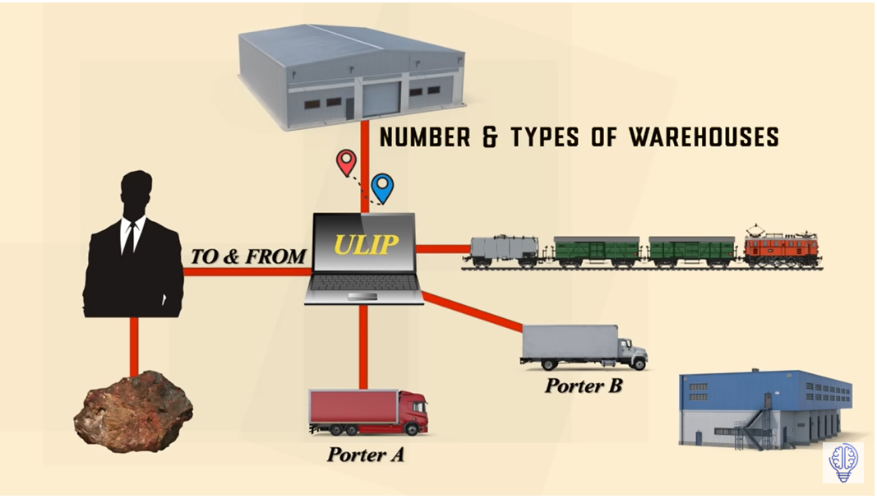
Simple Overview of the Logistics Model

Slide 4
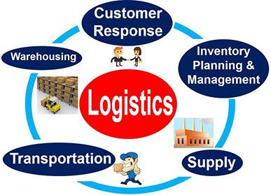

Slide 5
Key pillars of Logistics Policy
Material Sourcing
Transportation
Order fulfillment
Warehousing
Demand Forecasting
Inventory Management
Supply chain management

Slide 6
Business Solution with an example
Suppose there is truck with load coming buffalo need to deliver at Syracuse and there is another truck which is coming from New York need to deliver to Syracuse Hub and another truck coming from Dayton. When all the trucks reach Syracuse Hub, they get unloading all the goods and trucks remains empty, instead of remaining empty and running empty back we will use the hub for the user or company which like if they want to deliver goods to Dayton or New York they will drop at Syracuse hub and will reloaded in the trucks which are going back to Dayton or New York so here instead of truck leaving empty or when they unable to find the goods to refill the hub provides a platform to reload the trucks. Which helps the trucks get filled with goods and reduces the usage of trucks instead of using 6 trucks we only use 3 trucks which saves fuel,trucks are will filled with load always.

Slide 7
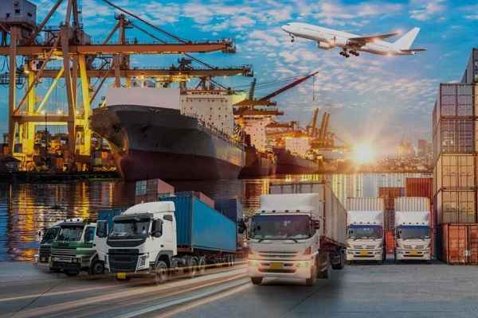
Goals
The purpose of logistics management is to deliver the right product to the right place at the right time.The logistics management tries to account for every conceivable contingency that could impact this delivery to the final customer.
The main goals of the logistics policy is :
Minimizing the manufacturing Costs
Efficient Flow of Operations
Provides a competitive Edge

Slide 8
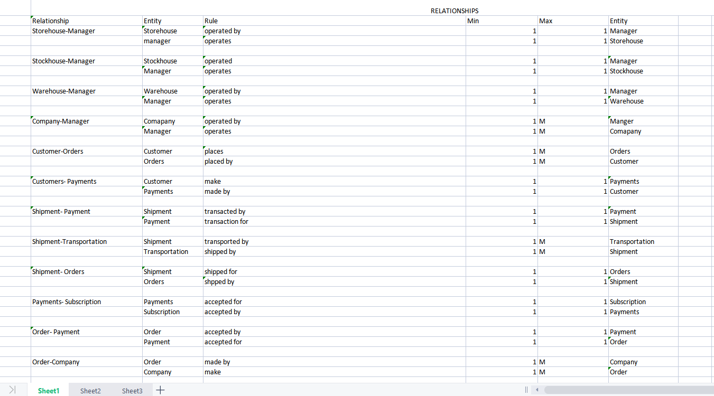
ER Data Requirements

Slide 9
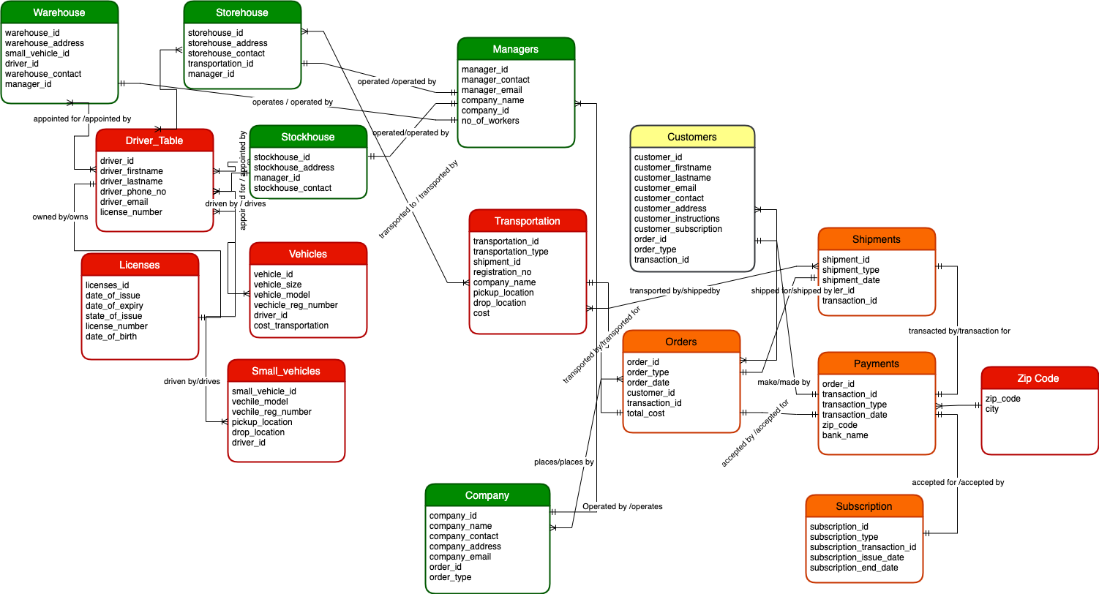
Conceptual Model

Slide 10
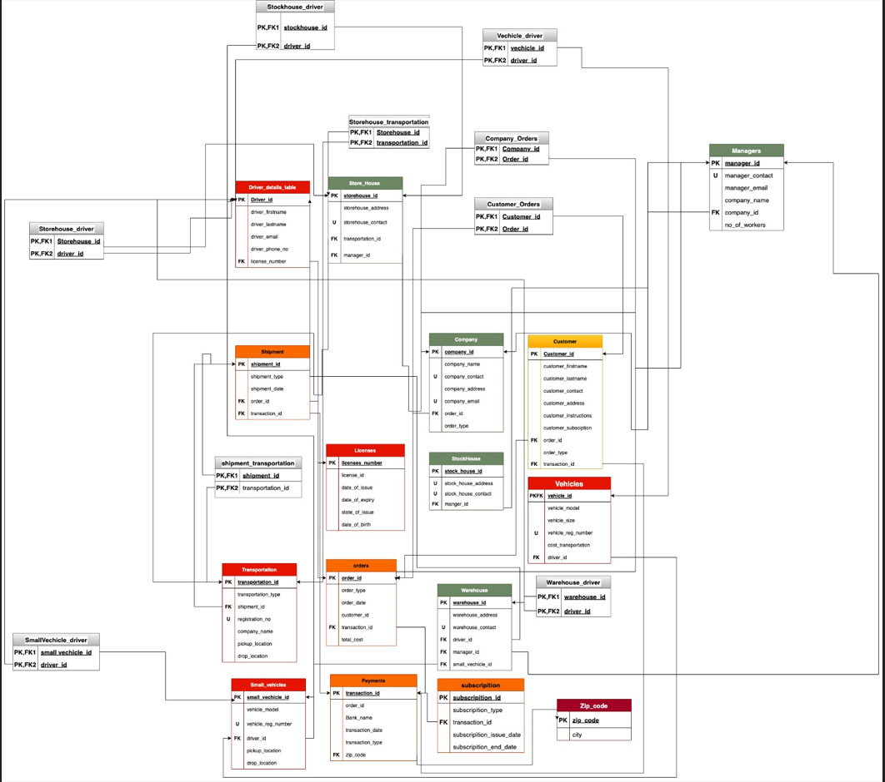
Logical Model

Slide 11
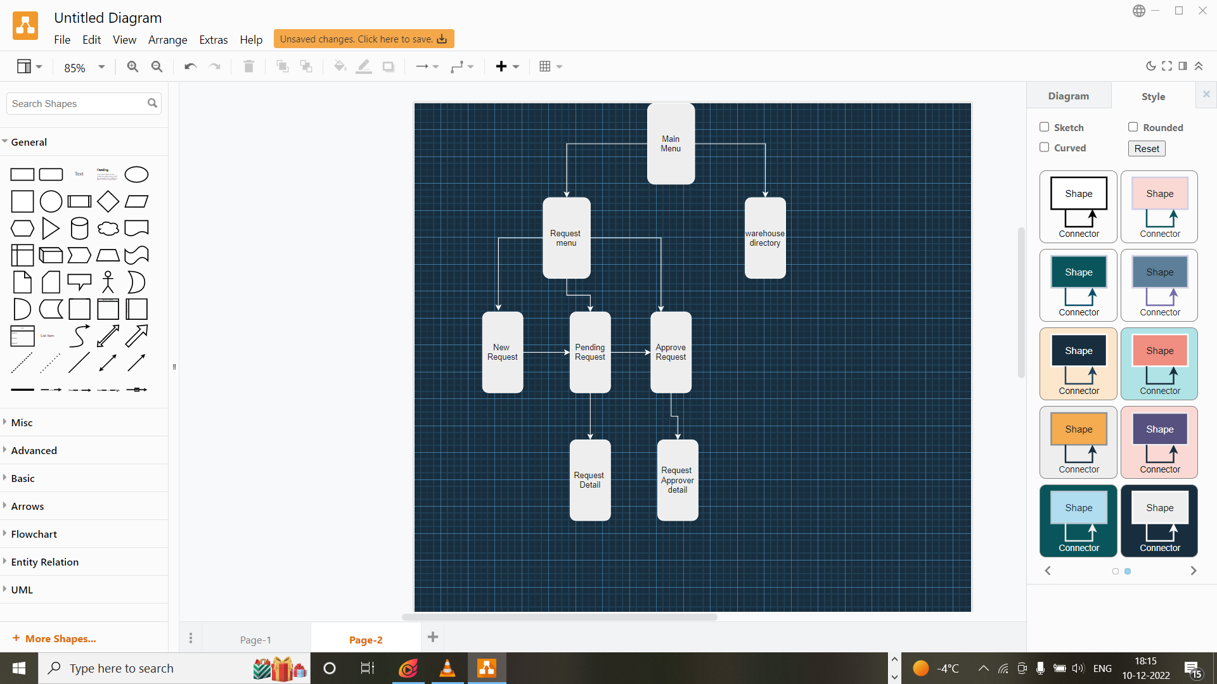
Express Logistics App
The Express Logistics App includes :
Main Menu
Request Menu
Warehouse Directory
New Request
Pending request
Pending request detail
Approve request
Approver request detail

Slide 12
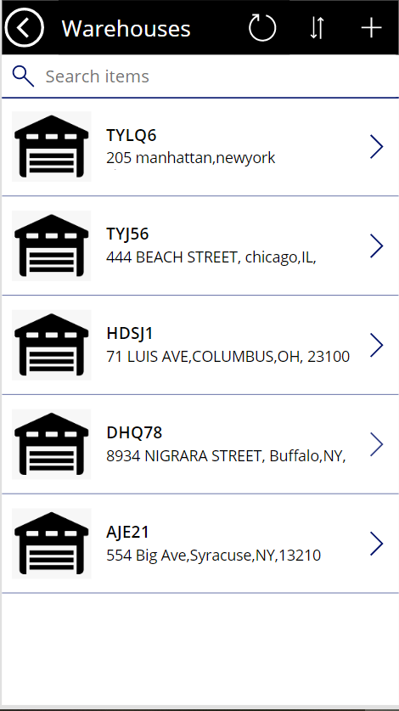
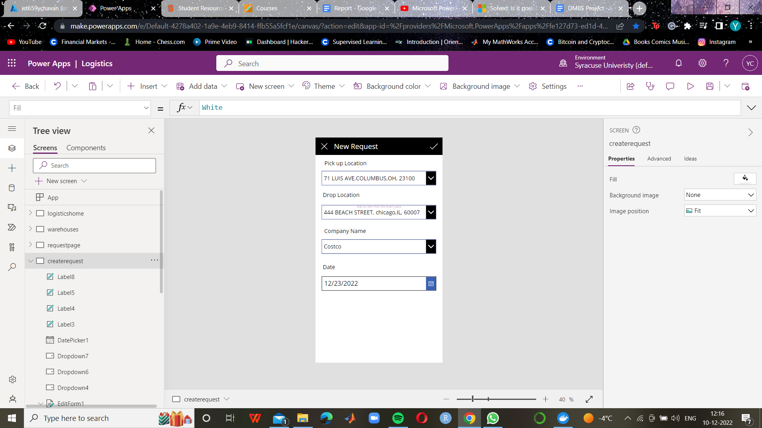
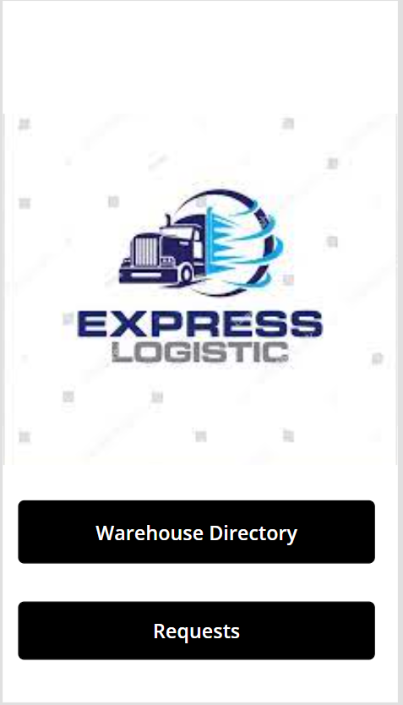
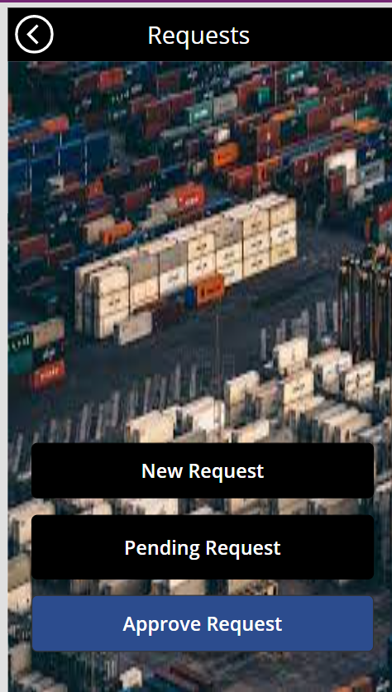
UI Design

Slide 13
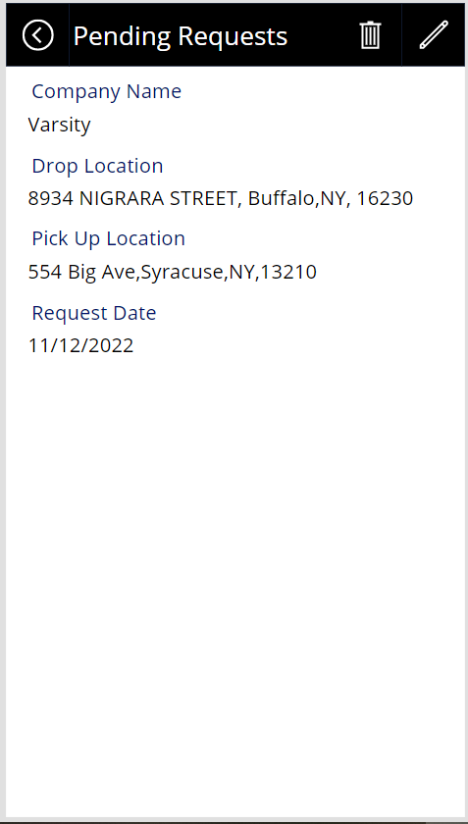
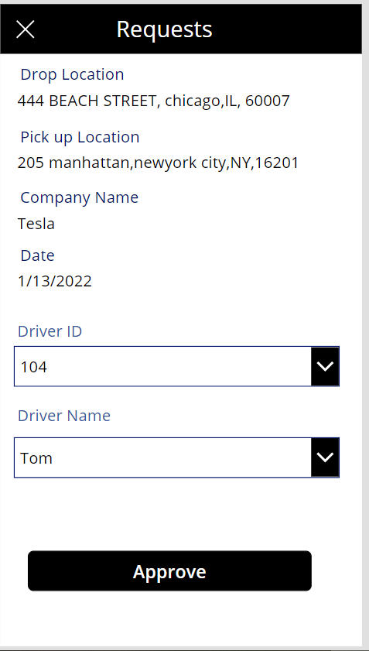
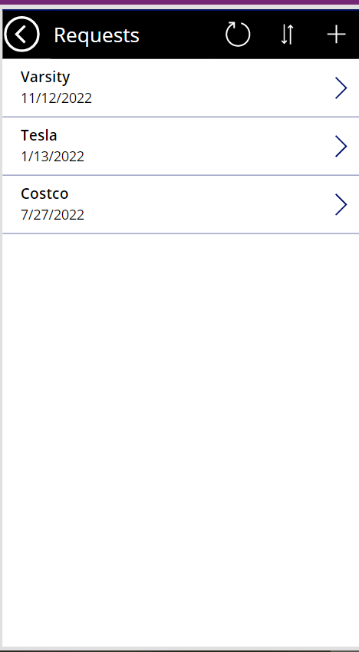


Slide 14
Thank You

